Slide 1
Unit 6 – Section 2
Dental Radiograph Analysis Checklist
Step 1
Too Dark or Too Light?
Step 2
Tooth Length
Step 3
Plate or Tube?
Go to Step 1
Go to Step 2
Go to Step 3

Slide 2
Step 1: Is the image too dark or too light?
Figure A
If the image is too light it will look washed out – too much white (Figure A)
If the image is too dark, parts of the tooth will disappear because the are burnt out. (Figure B)
No? – Go to Step 2
Are the setting aligned to the tooth and the patient weight?
Figure B
Yes?
No
Go to Step 1
Go to Step 2
Go to Step 3

Slide 3
Settings made for correct tooth and correct patient weight.
Too Light?
Too Dark?
Go to Step 1
Go to Step 2
Go to Step 3

Slide 4
Image is too light?
Increase kVp or time in 10% increments and reshoot until the desired quality is achieved
Problem Solved?
Yes?
No?
Go to Step 1
Go to Step 2
Go to Step 3

Slide 5
Image is too dark?
Decrease kVp or time in 10% increments and reshoot until the desired quality is achieved
Problem Solved?
Yes?
No?
Go to Step 1
Go to Step 2
Go to Step 3

Slide 6
Settings NOT made for correct tooth and correct patient weight.
Check instruction guide or call customer support for help with adjusting the settings by tooth type and patient size.
Despite using correct settings, image is still too light or too dark
Too Light?
Too Dark?
Go to Step 1
Go to Step 2
Go to Step 3

Slide 7
Setting changes have not solved the problem?
Call technical support through the manufacturer of your x-ray sensor
Problem solved?
Yes
No
Go to Step 1
Go to Step 2
Go to Step 3

Slide 8
Technical support has not solved the problem?
Call customer support through the manufacturer of your dental x-ray unit. This may mean a service call to be sure the unit is functioning properly.
Step 2

Slide 9
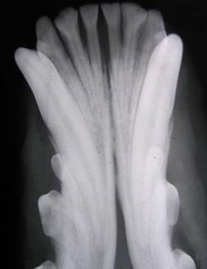
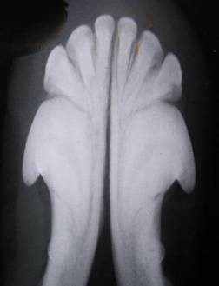
Step 2: Tooth Length
Figure A
Is the image of the tooth longer (Figure A) or shorter (Figure B) than normal?
No?
Figure B
Too Long
Too Short
Go to Step 1
Go to Step 2
Go to Step 3

Slide 10
Tooth Image Too Long
The beam is perpendicular to the long axis of the tooth
Tube
Head
Problem solved
Sensor Plate
Solution: Tilt the tube head 10 degrees more perpendicular to the sensor plate.
Tube
Head
Sensor Plate
Go to Step 1
Go to Step 2
Go to Step 3

Slide 11
Tooth Image Too Short
Tube
Head
The beam is perpendicular to the sensor plate
Problem solved
Sensor Plate
Solution: Tilt the tube head 10 degrees more perpendicular to the long axis of the tooth.
Tube
Head
Sensor Plate
Go to Step 1
Go to Step 2
Go to Step 3

Slide 12
Step 3: Sensor plate or tube head?
Figure A
Cut off root
Missing parts of the tooth is a sensor plate issue (Figure A). An area of demarcation where the rest of the tooth is beyond the tube head’s edge (cone cutting) is a tube head issue (Figure B).
Tooth is in the correct position.
Figure B
Portion of the tooth cut off?
Cone cutting?
Go to Step 1
Go to Step 2
Go to Step 3
Cone Cutting

Slide 13
Portion of the tooth is cut off.
Look at the image.
Is there an area of black beyond the edge of the tooth crown
Yes?
No?
Go to Step 1
Go to Step 2
Go to Step 3

Slide 14
There is an area of black.
Move the sensor plate towards the tooth root and reshoot until the root plus 2mm of periapical space is visible. Your new image should show a decrease of wasted space.
Move the plate towards the roots
Wasted space
Success?
Tooth portion still missing?
Go to Step 1
Go to Step 2
Go to Step 3

Slide 15
If the reshoot corrected the wasted space but the roots are still cut off
Shorten the image!
Solution: Tilt the tube head 10 degrees more perpendicular to the sensor plate.
Tube
Head
Sensor Plate
Image is correct!
The entire tooth should now be seen.
Tube
Head
Sensor Plate
Go to Step 1
Go to Step 2
Go to Step 3

Slide 16
There is an area of black.
Lift the patient’s lip and check the alignment of your tube head to the plate. Commonly you will see the plate beyond the edge of the tube head.
Move the tube head so that it is aligned completely over the sensor. Your new image will show the missing area has been included.
Keep making adjustments to the alignment until the image is correctly positioned
Image is correct
Go to Step 1
Go to Step 2
Go to Step 3

Slide 17
Move on to the next tooth in the series.
Be sure to follow the 3-step checklist after shooting each radiograph.
Step 1 – Is the image too dark or too light?
Step 2 – Is the image too long or too short?
Step 3 - Sensor plate or tube head?
Repetition is the mother of learning
Keep practicing to increase your chance of success.
Ask a colleague to help you if you are unable to solve the problem.
Think of the important information you are sharing with the doctor. This information will improve your patient’s quality of life.
YOU CAN DO THIS!
Congratulations!
This Photo by Unknown Author is licensed under CC BY-NC-ND

